Slide 1


B. Tech Project On Music Compiler
Presented By:
Harshit Mathiyan(2200680130022)
Hemant Chaudhary(2200680130023)
Madhav Garg (2200680130030)
B. Tech 3rd Semester
Under The Guidance:
Nikhil Kumar Walia sir
(IT Department , MIET)
Department of Information Technology
Meerut Institute of Engineering & Technology, Meerut
Email: hemant.chaudhary.it.2022@miet.ac.in

Slide 2
Table Of Content
Introduction
Abstract
Problem Statement
Survey
Methodology
Experimental Details
Result
Conclusion
References

Slide 3
INTRODUCTION
Our music software is designed to offer a seamless and enjoyable music streaming experience .
This music software allows users to log into the system, add albums, and songs to the playlist .
It combines an extensive music library with personalized features, making it easy to discover and enjoy their favourite .
This music software also has music download capabilities, allowing users to listen to music even when they are not connected to the internet .
The primary goal of our app is to provide users with an easy to use platform for streaming music .

Slide 4
Social sharing is also available while using this software .
The idea for this app stemmed from the growing demand for high quality music streaming services . With more people turning to digital platforms for their music needs, we saw an opportunity to create an app that not only meets these needs but also offers unique features that set it apart from existing services .

Slide 5
Abstract
Basically, our software is a cutting – edge music software designed to enhance the way users discover, listen to, and share music . Our app leverages advanced technology to provide seamless, personalized, and engaging music streaming experience . Key features include an extensive music library, intelligent recommendation algorithms, and sharing capabilities, all housed within an intuitive and user friendly interface .

Slide 6
Problem Statement
Despite the proliferation of music streaming services, users still encounter
several challenges that hinder their overall listening experience . Our music
app aims to address the following key problems:
Discoverability of New Music
User Experience
Personalization
Offline Access
Social Connectivity

Slide 7
Survey
Who is your favourite music artist / band ?
Do you attend live music concerts or festivals ?
What is your preferred language of music ?
Which musical instruments can you play ?
What is your favourite music genre ?
How likely are you to pay for premium music app subscription ?

Slide 8
Methodology
Methodology means what method or process is use in research study
and investigation .
Or in programming means which programming language we use to
prepare a website .
In our software we mainly use two languages to develop our basic app….
HTML
CSS
Java Script

Slide 9



Technology Used
It uses tag to the structure content , define elements , and establish the layout of a webpage
It defines how elements are styled , including aspects like
color , font ,
spacing , and
positioning
It runs in web browsers , and it provides functionality to our website

Slide 10
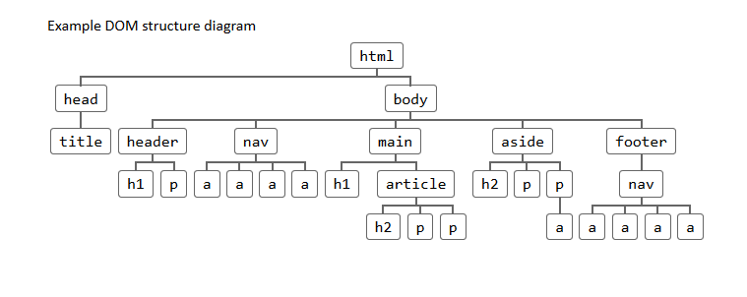
Flow Chart

Slide 11
Experimental Details
The objective of conducting experiments on the music software
app is to thoroughly access and evaluate its usability ,
functionality and overall user experience .
This involves breaking down the over arching goals into specific
components to gain comprehensive understanding of how
well the app meets the needs and expectations of its
intended user .

Slide 12
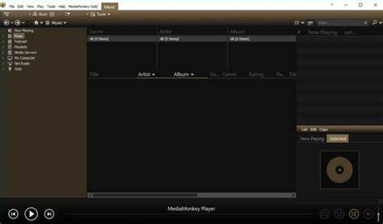
Result

Slide 13
Conclusion
The evaluation of Music Software has provided valuable
insights into the platform usability ,functionality , and overall
user experience. Through a comprehensive analysis of both
quantitative metrices and qualitative feedback .
Analysis helps us to provide safe and trusted software for users
and helps developers to provide best service to their
users .

Slide 14
References
https://www.google.co.in/
https://openai.com/chatgpt
https://github.com/
https://www.youtube.com/

Slide 15
Thank You

